Slide 1



Pranjal Kumar
Particle Swarm Optimization based scheduling algorithm in Cloud Computing
Presented by:
Load Balancing Mutation a particle swarm optimization (LBMPSO) based schedule and allocation for cloud computing
Pranjal Kumar
20010130
CSE20137
Group: 13
Ms. Sampa sahoo
CGU Odisha

Slide 2


Pranjal Kumar
Problem Statement:
Most scheduling algorithms do not consider reliability and availability of the cloud computing environment because the complexity to achieve these parameters. We propose mathematical model using Load Balancing Mutation (balancing) a particle swarm optimization (LBMPSO) based schedule and allocation for cloud computing that takes into account reliability, execution time, transmission time, make span, round trip time, transmission cost and load balancing between tasks and virtual machine.
LBMPSO can play a role in achieving reliability of cloud computing environment by considering the resources available and reschedule task that failure to allocate. Our approach LBMPSO compared with standard PSO, random algorithm and Longest Cloudlet to Fastest Processor (LCFP) algorithm to show that LBMPSO can save in make span, execution time, round trip time, transmission cost.
CGU Odisha

Slide 3

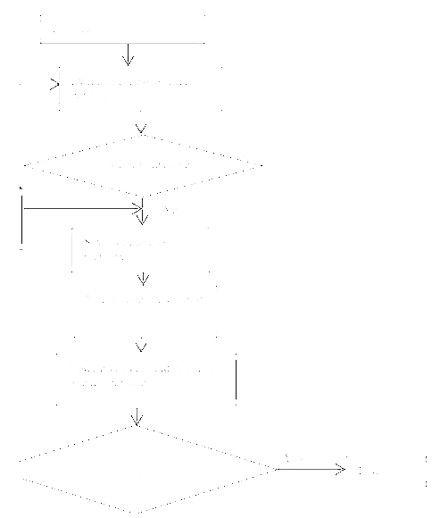
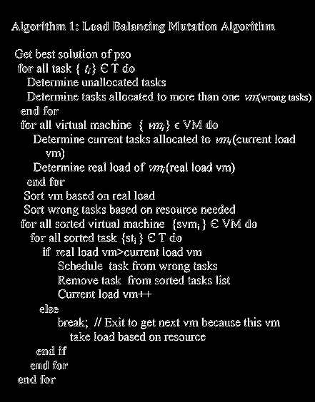

Algorithm
Pranjal Kumar

Slide 4
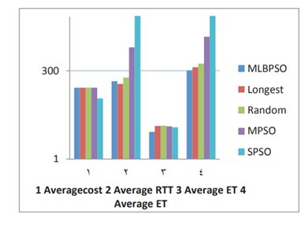
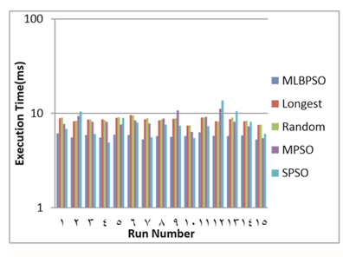
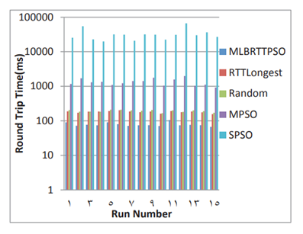
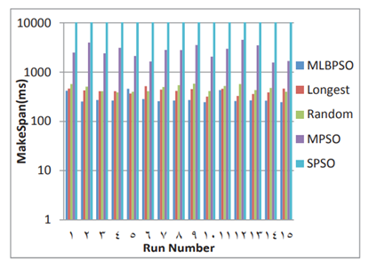
Experimental Analysis
Pranjal Kumar
01
02
03
04

Slide 5

ADVANTAGES
DISADVANTAGES
Considers reliability and availability of the cloud computing environment
01
Difficult to operate because of higher number of variables and complex computing structure.
01
Results show the PSO algorithm not only converges faster but also runs faster than the other two algorithms in a large scale
More costly to implement than traditional approaches for working at lower scales.
02
02
Fail to allocation & allocation to more than one VM are solved by LBPSO
More prone to bugs because of its internal nature.
03
03
Pranjal Kumar

Slide 6




Pranjal Kumar
Conclusion
In conclusion we can say that, LBMPSO improves the Reliability of cloud computing and good distribution of tasks onto resources compared to other algorithms. We found that round trip time load balancing mutation PSO can achieve the best compared to other algorithms. In addition, proposed algorithm take in account the load balancing when distributing tasks to available resources, tasks assign as earlier as possible, finished as earlier as possible and reschedule failure tasks. It can be used for any number of tasks and resources.

Slide 7
Pranjal Kumar | CGU Odisha
Load Balancing Mutation & Particle Swarm Optimisation
Journal: Procedia Computer Science 65 (2015) 920 – 929
Publication: Enhanced Particle Swarm Optimization For Task Scheduling In
Cloud Computing Environments
Author: Enhanced Particle Swarm Optimization For Task Scheduling In
Cloud Computing Environments
Thank You
for your attention
Presented by:
Pranjal Kumar
20010130
CSE20137
Group: 13

